Slide 1
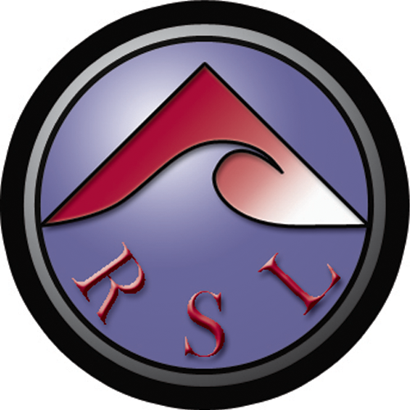

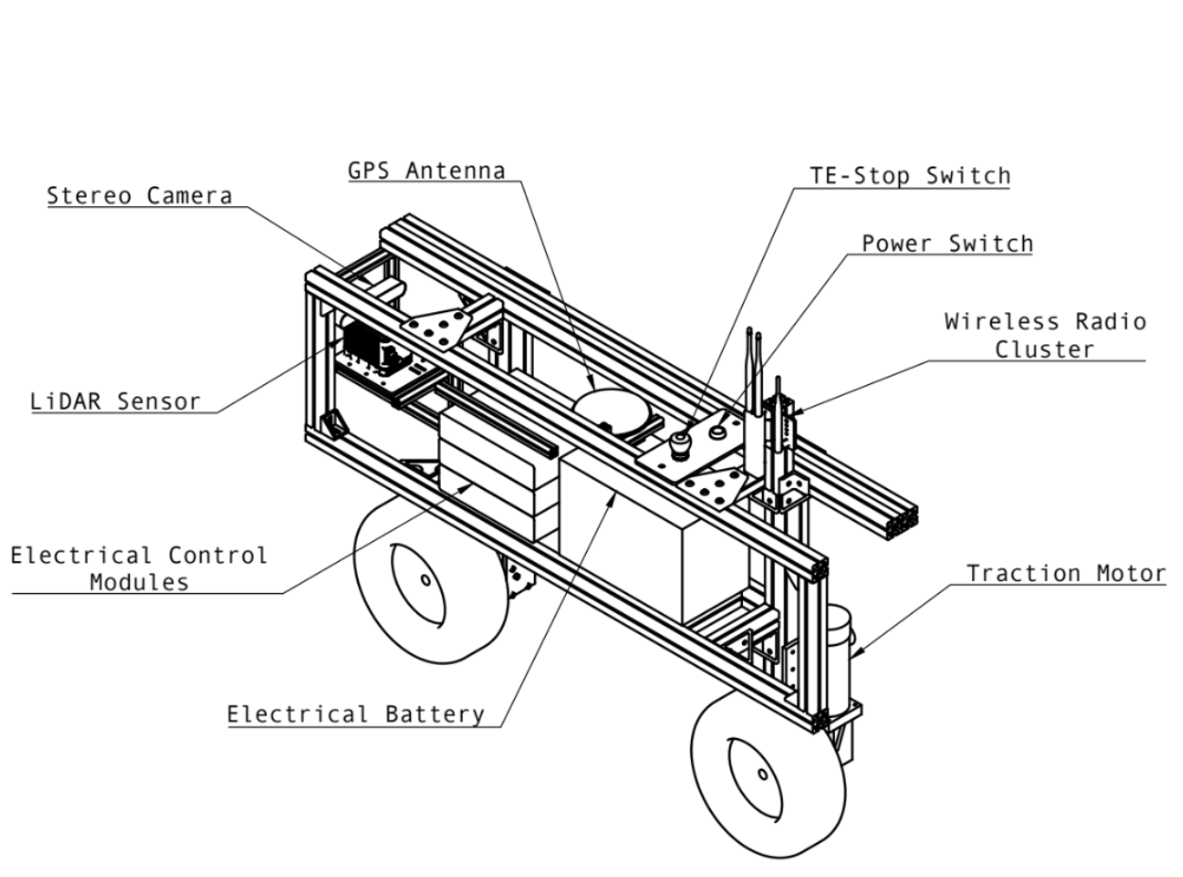
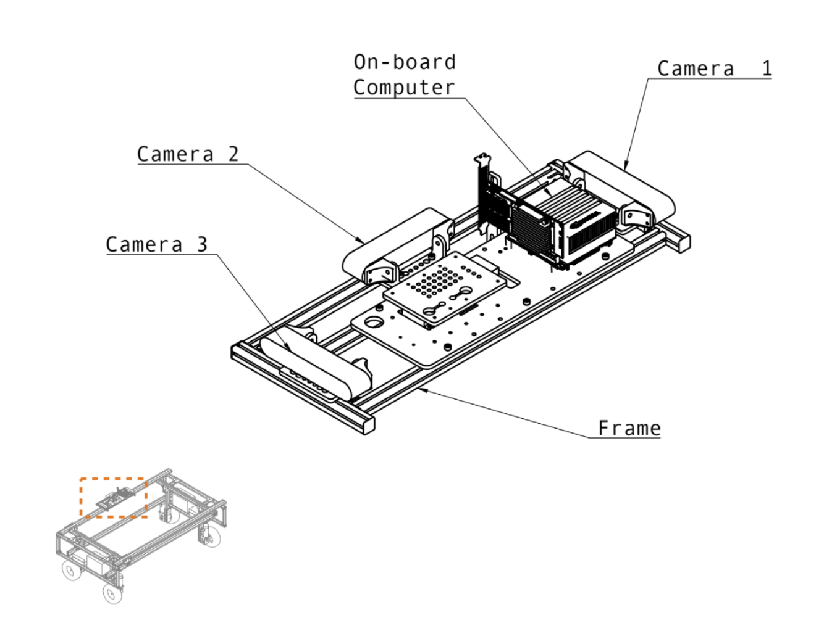
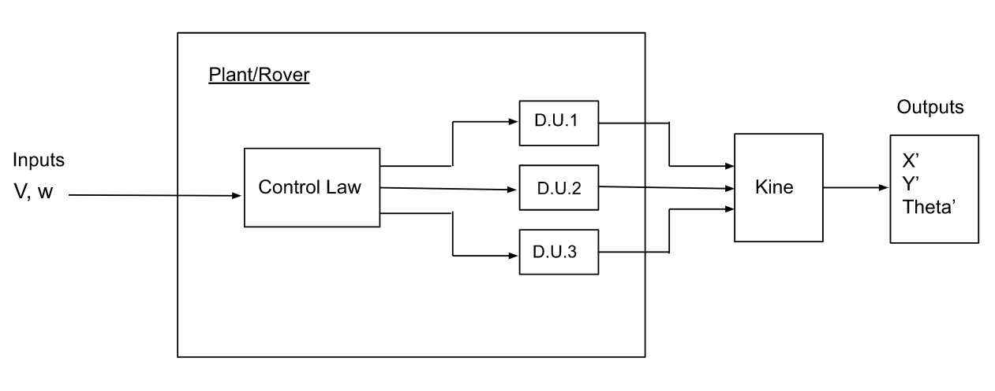
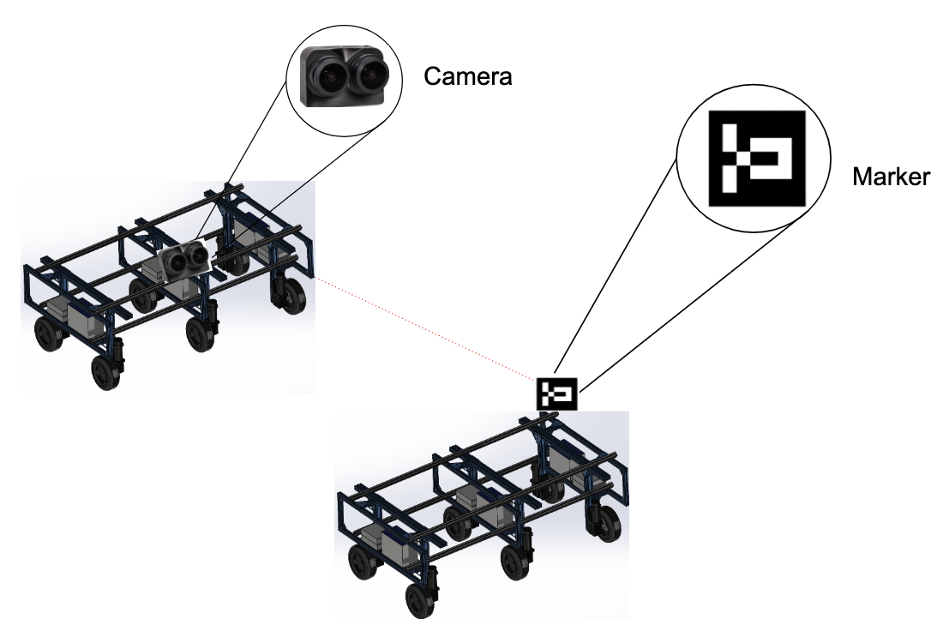
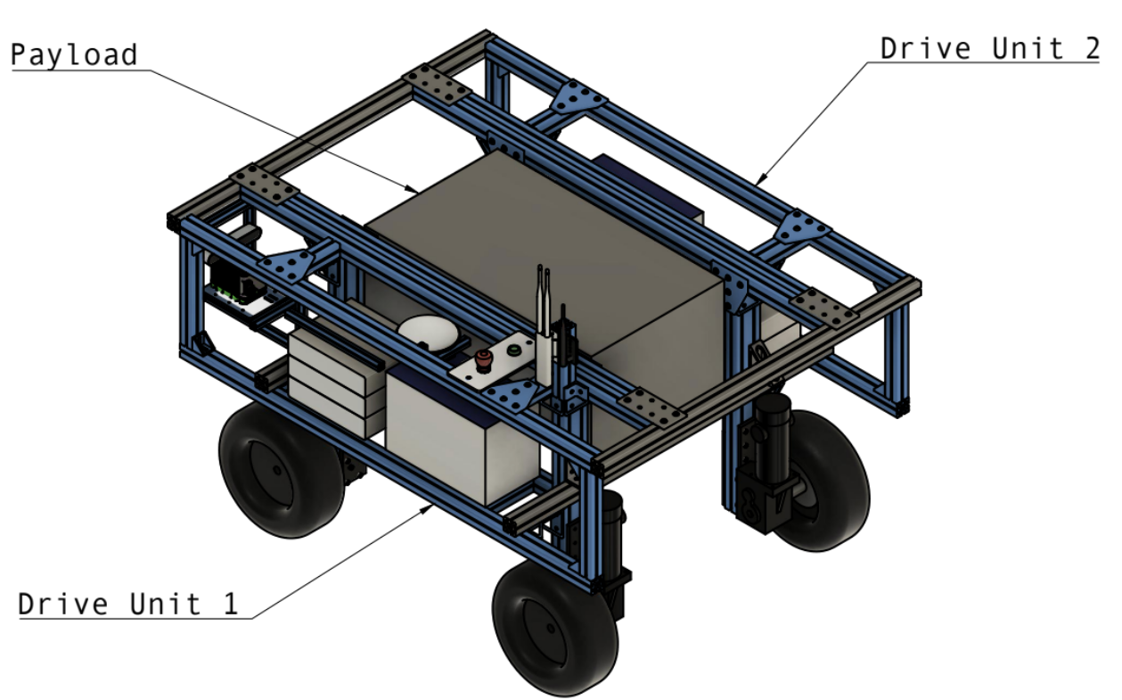
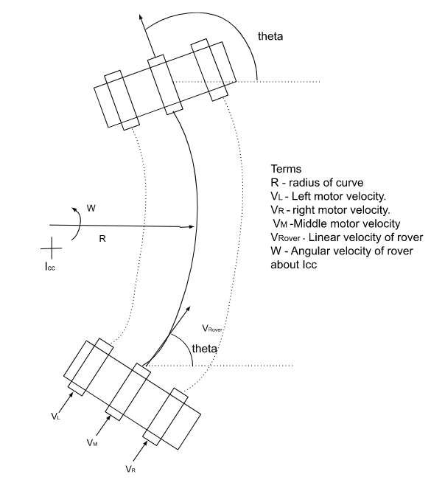
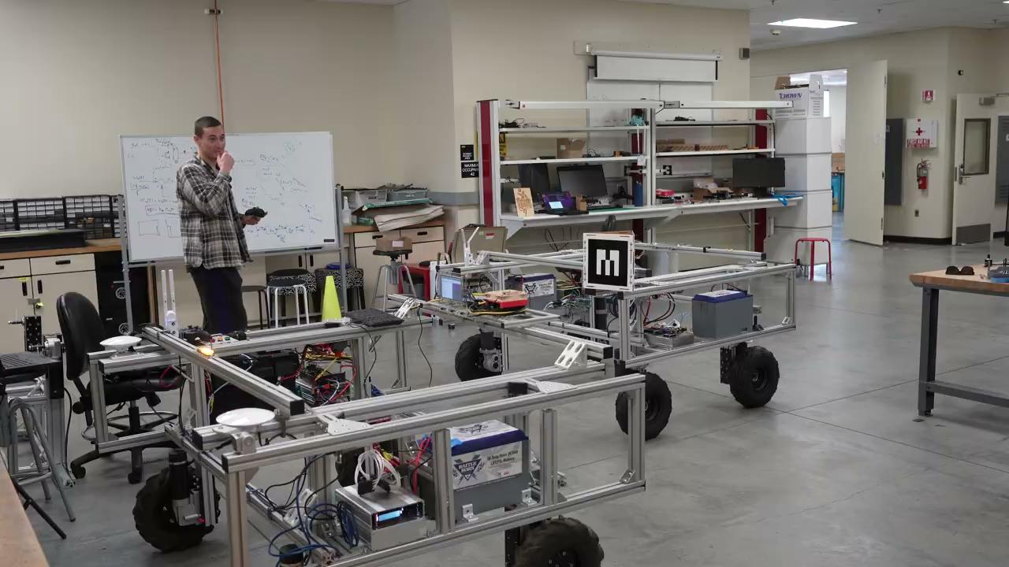
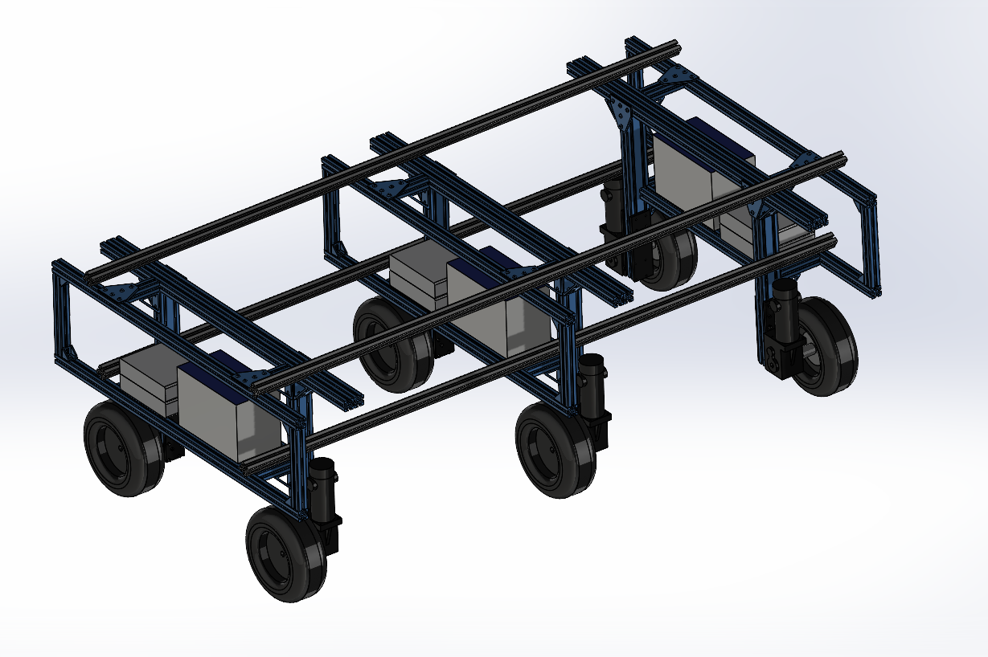
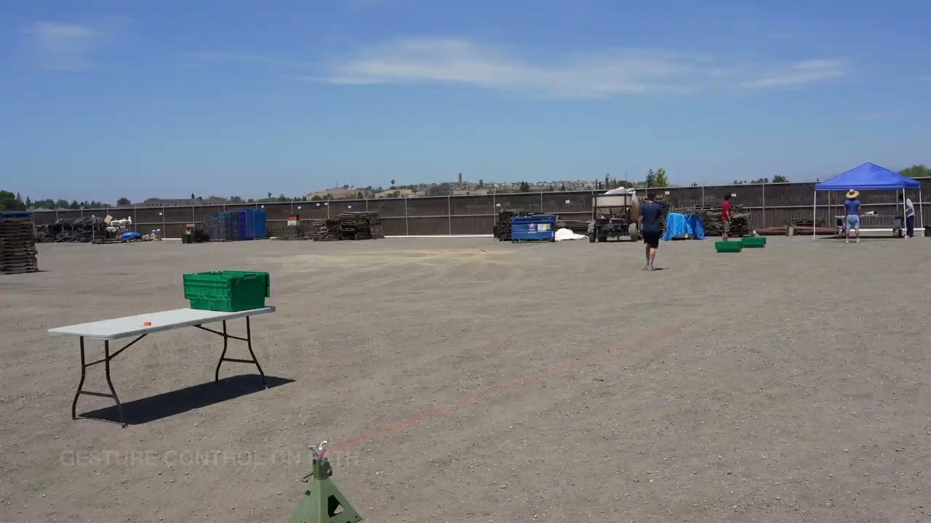
Multi-robot Collaboration & Multiple Drive Motion Control of an Autonomous Agricultural Rover
Christopher Waight
Advisor: Dr. Christopher Kitts
Abstract
Background
Control Architecture
This study focuses on:
The development of a decentralized control structure which utilizes advanced communication and decision making algorithms to enable collaboration among robots.
The design of a unique modular hardware configuration that allows for extra storage space, more sensors/implements, additional drive units, etc. Currently researching using more than two motors for differential drive of the rover and its kinematics.
This project aims to build a highly modular rover, capable of adapting its size to task, often by extending its width thereby motivating the need to adapt kinematic transforms. Also, it researches the need for multi-agent collaboration in farming through close proximity position control of multiple rovers starting with coordinated tasks like harvesting, offloading materials etc. This rover uses a differential drive system for maneuvering and computer vision for more precise movements.
Linear/Angular Velocity Control – Motor control is important to controlling the linear and angular velocity of the rover, this is how we get the desired motion.
Fig. 1 : Drive Unit overview
Fig. 2 : Computer Vision Module
Multi-robot Collaboration
Multiple Drive Motion Control
Developing a 2-Dimension lead-follower navigation control architecture.
Modular: multiple drive units, extra storage space
Given motor inputs what is end position and orientation, or inversely, if I want to go to a position with a certain orientation, what do I need to send to my motors
Fig. 4 : Control Architecture Overview
Conclusion
Applications
A unique hardware configuration is being developed and tested as well as the introduction of control algorithms for multiple robot collaboration in farming.
In-field collaborative activities – Unloading farm produce or materials from another robot, replenishing reducing substances like liquids for sprayers etc.
Navigation – Traversing multiple crop rows at once in order to cover a large area more quickly and efficiently
Fig. 3 : Lead-Follower Structure
Future Work
A hybrid control algorithm that combines PID and vision-based control is being used for this application.
Develop field level path planning to autonomously navigate multiple crop rows simultaneously
Development of a precise docking mechanism for the follower robot(s) to aid operations like produce transer, liquid refill, docking etc.

